Slide 1

Introduction to Mobile Applications
Mobile applications, or apps, are software designed to run on mobile devices like smartphones and tablets. This presentation will compare different app types and explore various aspects of mobile app development.

Slide 2
Major Types of Mobile Applications
Native Apps: Native apps are developed specifically for a particular platform (iOS or Android) using platform-specific languages. They offer high performance and a seamless user experience.
Progressive Web Apps (PWAs): PWAs are web applications that provide a native-like experience on mobile devices. They are accessible through browsers and can work offline, making them versatile and user-friendly.
Hybrid Apps: Hybrid apps combine elements of both native and web apps. They are built using web technologies but are wrapped in a native container, allowing them to be distributed through app stores.

Slide 3
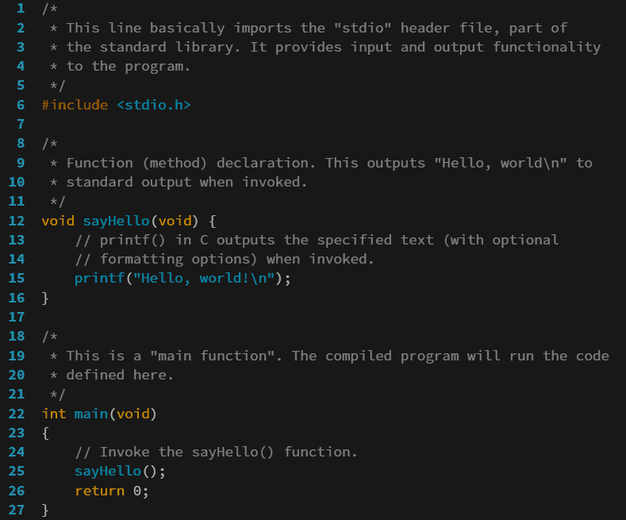
Mobile App Programming Languages
Native Languages:
Swift: Used for iOS app development.
Kotlin: Preferred for Android app development.
Cross-Platform Languages:
Dart: Utilized with the Flutter framework for building apps across platforms.
JavaScript: Commonly used with frameworks like React Native.
Web-Based Languages:
HTML/CSS/JavaScript: The core technologies for developing Progressive Web Apps.

Slide 4
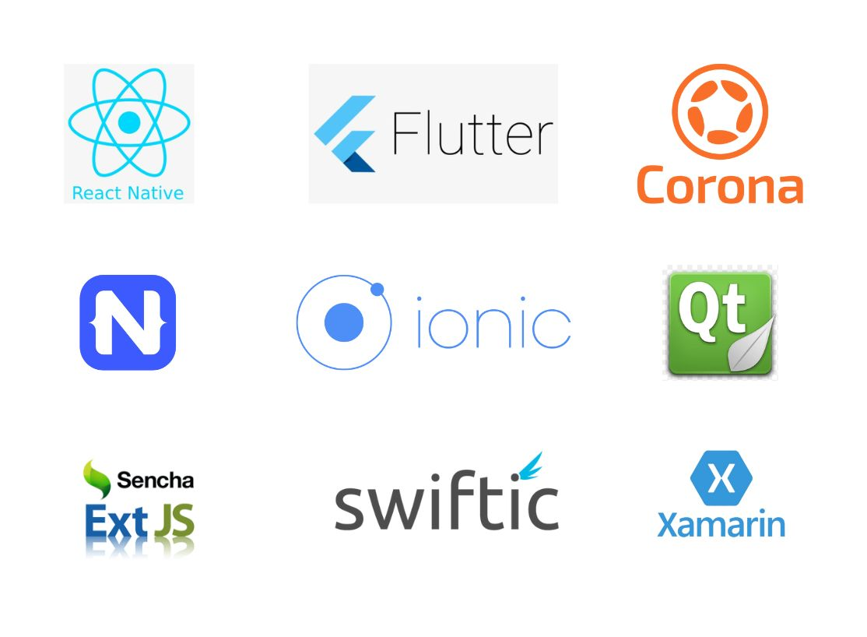
Mobile Development Frameworks
Native Frameworks:
SwiftUI: A framework for building iOS apps with a declarative syntax.
Android SDK: The official development kit for Android apps.
Cross-Platform Frameworks:
Flutter: A UI toolkit for building natively compiled applications for mobile, web, and desktop from a single codebase.
React Native: Allows developers to use React along with native platform capabilities.
Hybrid Frameworks:
Ionic: A framework for building hybrid mobile apps using web technologies.
PWA Frameworks:
Angular: Often used for developing Progressive Web Apps.

Slide 5

Mobile App Architecture & Design Patterns
Fundamental Layers:
Data Layer: Manages data storage and retrieval.
Business Layer: Contains the logic and rules of the application.
Presentation Layer: Handles the user interface and user experience.
Design Patterns:
MVC (Model-View-Controller): Separates application logic into three interconnected components.
MVP (Model-View-Presenter): Similar to MVC but emphasizes the role of the presenter.
MVVM (Model-View-ViewModel): Facilitates a separation of development of the graphical user interface from the business logic.

Slide 6

Requirement Engineering
Requirements engineering is the process of defining, documenting, and managing software requirements. It is crucial in mobile app development for ensuring that the final product meets user needs.
Feasibility Studies: Assessing the viability of the project.
Requirement Gathering: Collecting user and stakeholder requirements.
Validation: Ensuring that requirements are met throughout the development process.

Slide 7
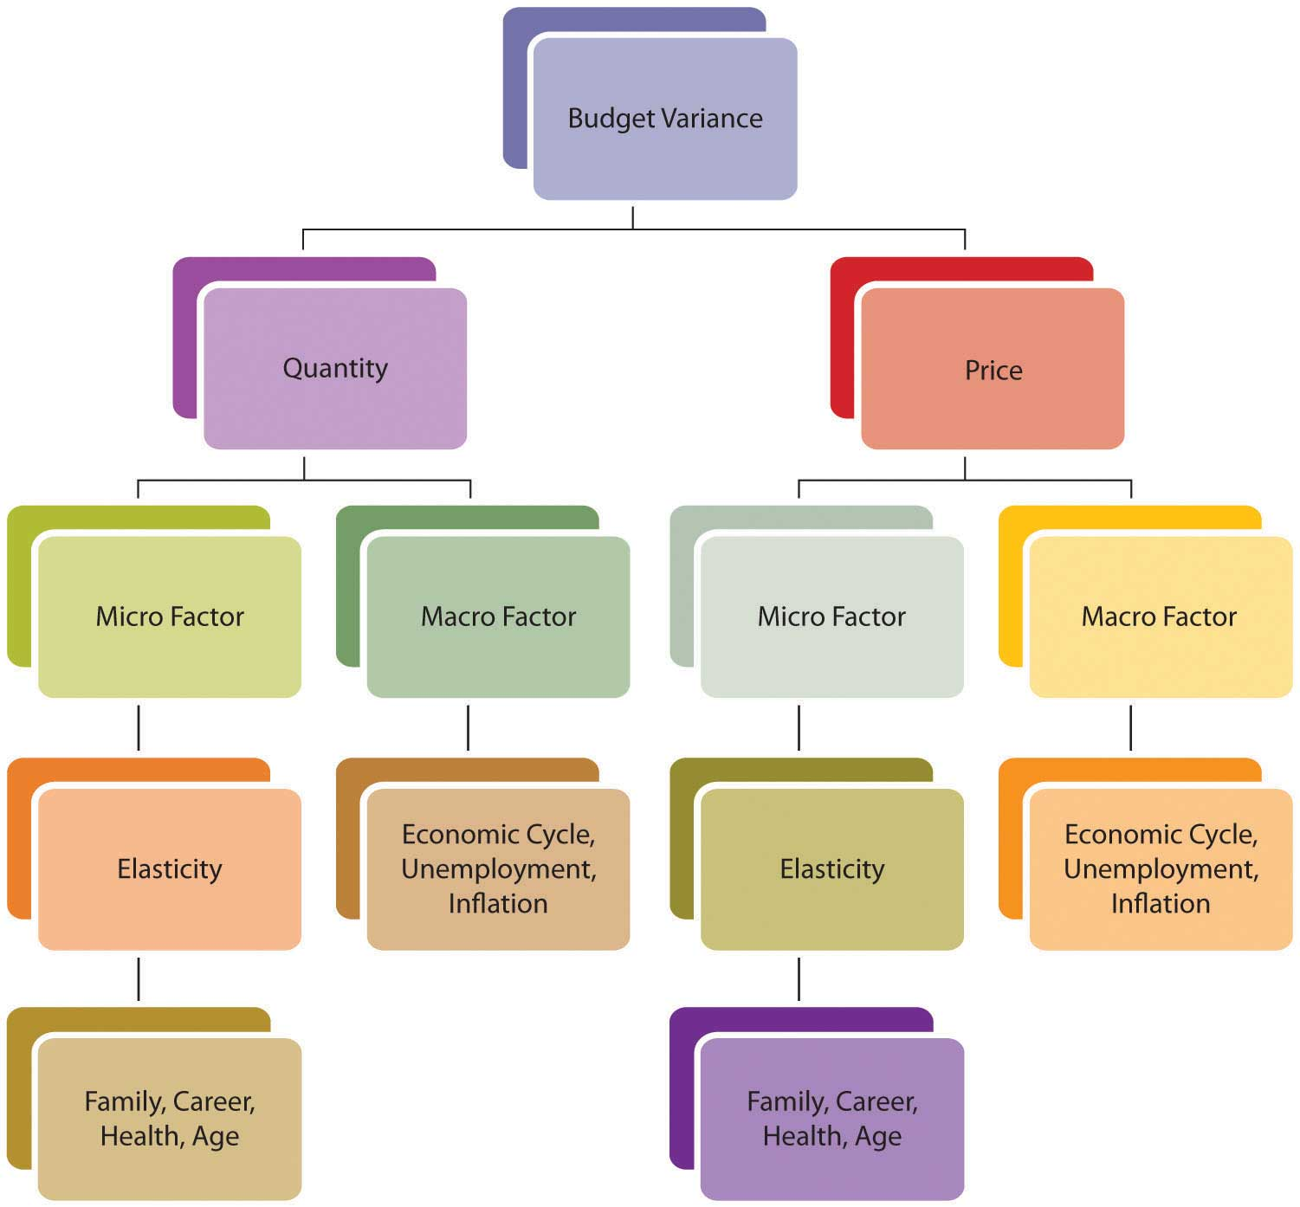
Estimating Mobile App Development Cost
Core Factors Affecting Budget:
Platform Selection: Choosing between iOS, Android, or both impacts costs.
Design Complexity: More intricate designs require more resources.
Developer Expertise: Experienced developers may charge higher rates.
Testing Scope: Comprehensive testing increases overall costs.
Extra Expenses: Consider costs for APIs, app store fees, and post-launch maintenance.

